Slide 1

Social portfolio
Kavyam Patel
10 A
Roll No. 22

Slide 2
Introduction
NAME: Kavyam Patel
Class: 10 Section: A
Roll No: 22
Website: https://kavyam-patel.pages.dev/
School: DAV International School
School Email: 2306_KAVYAM@davkharghar.net
Email: kavyam.spatel@gmail.com
Google Drive

Slide 3
Index
Website
Activities
Notes
Geography
Economics
History
Democratic Politics

Slide 4
WEBSITE

Slide 7
Activities
May Vacation Assignment
Consumer Awareness
Alternate Academic Activity
July

Slide 8
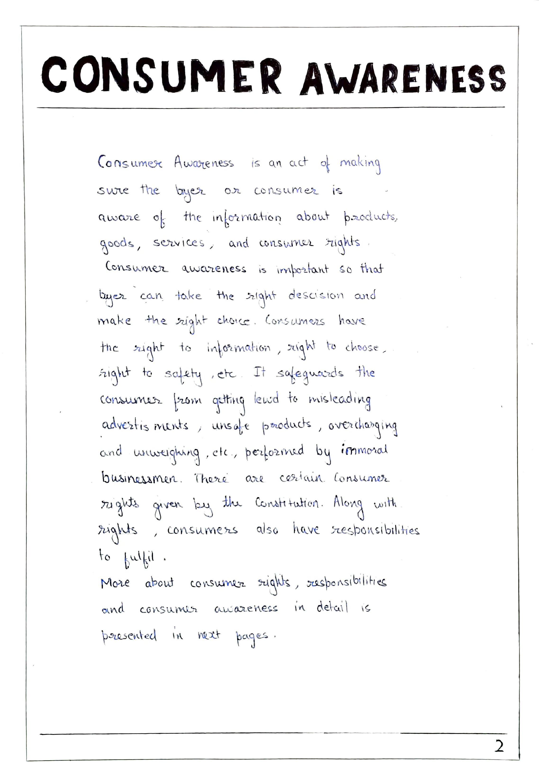

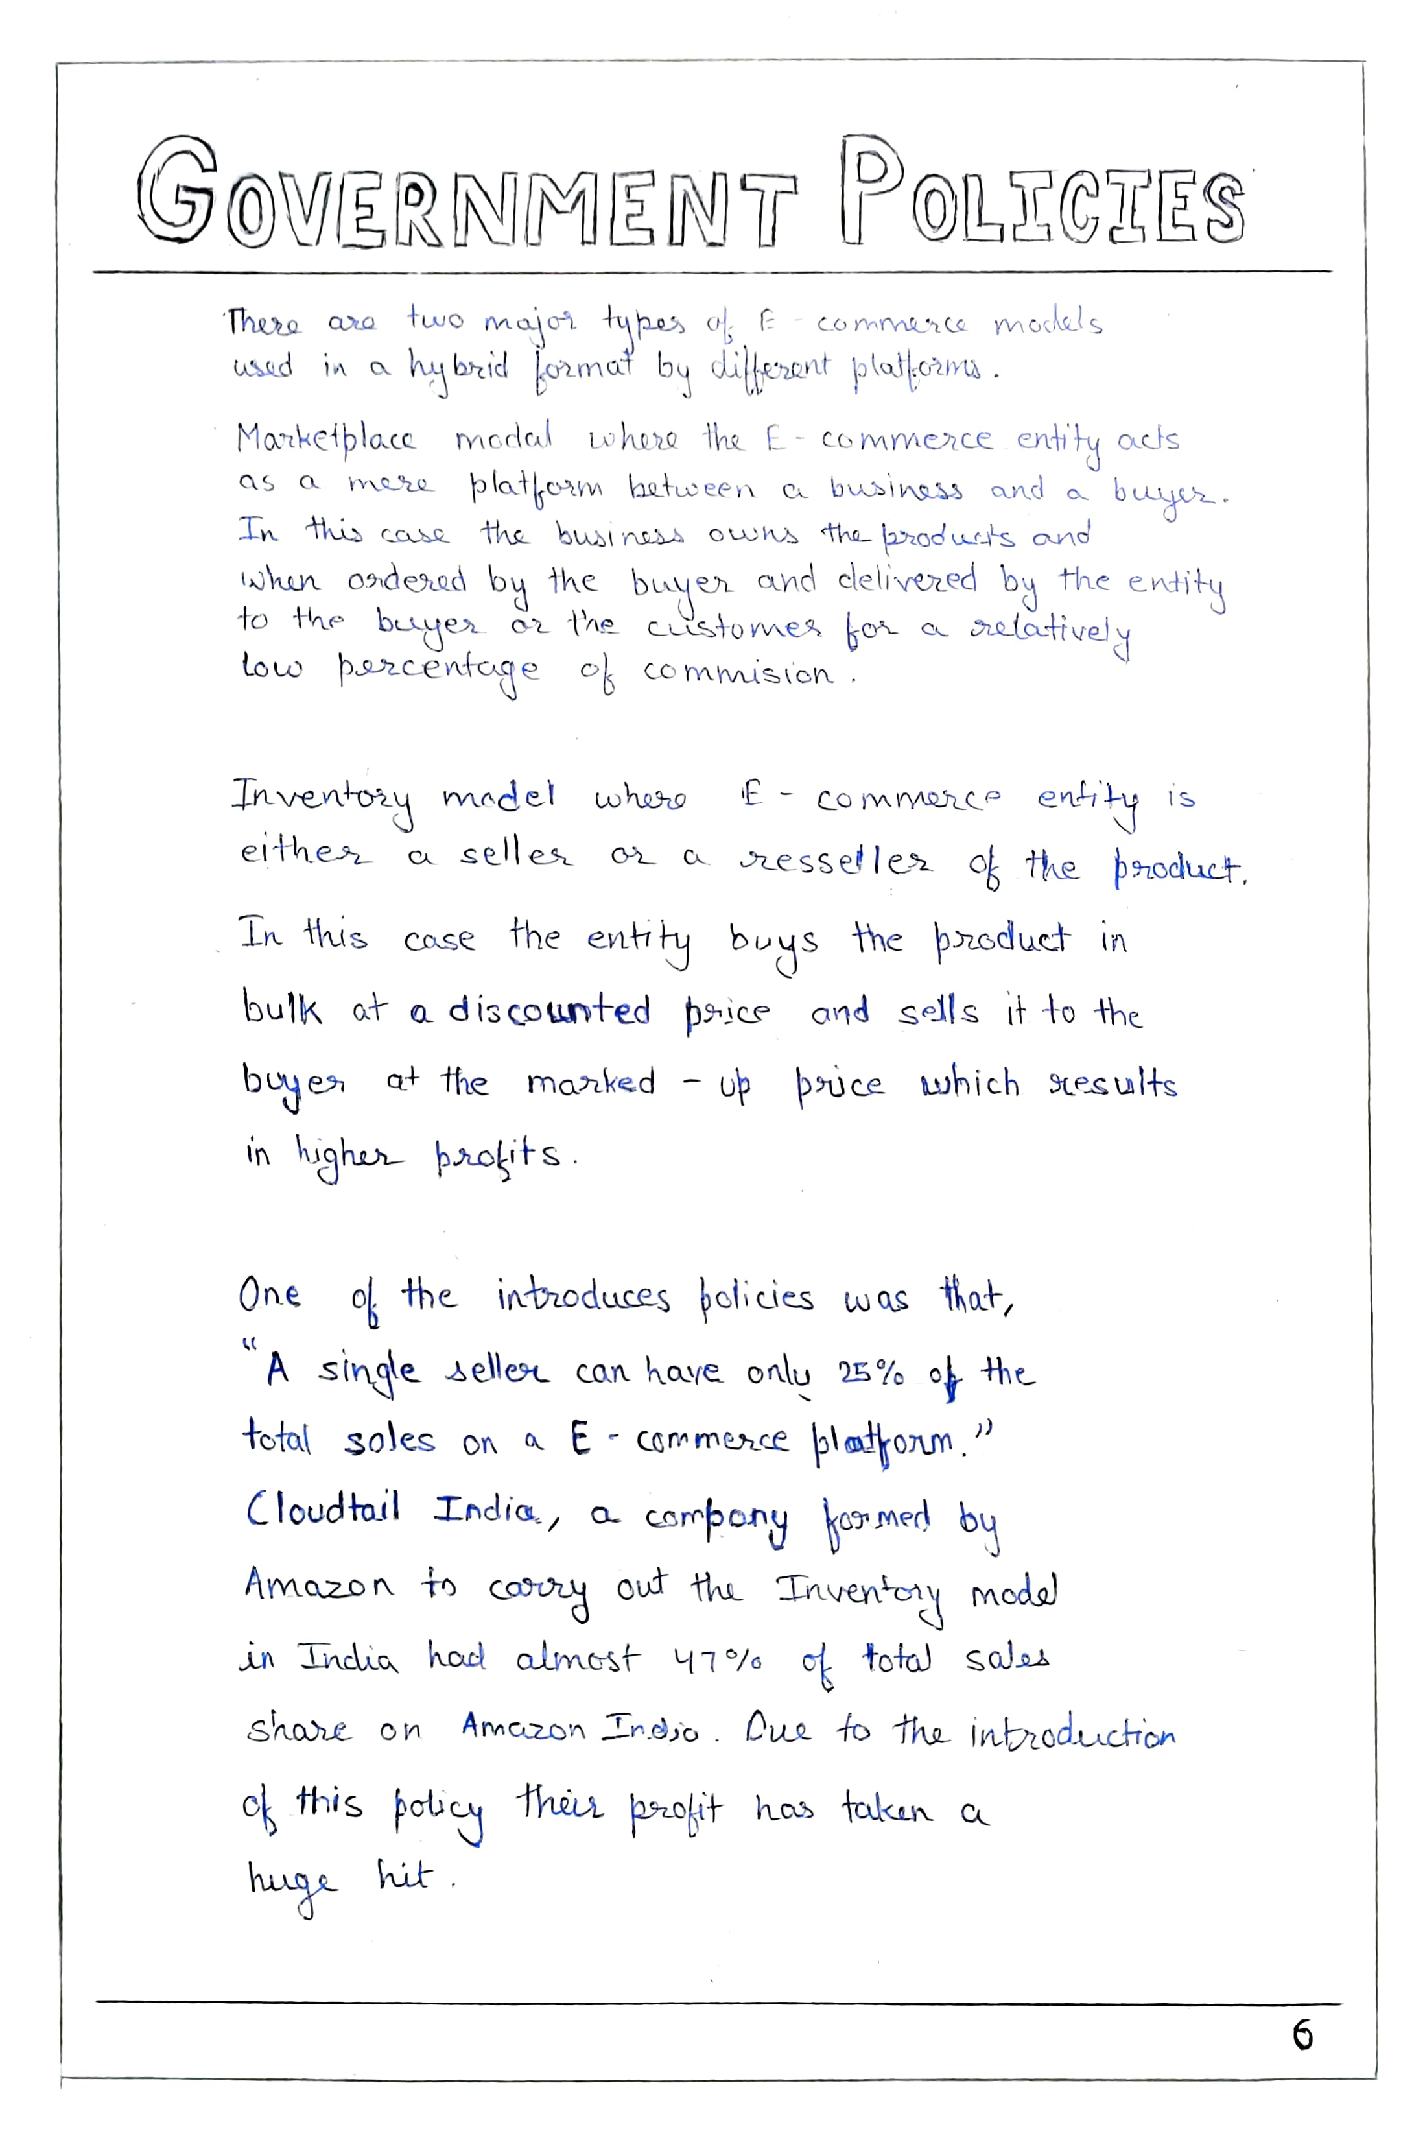
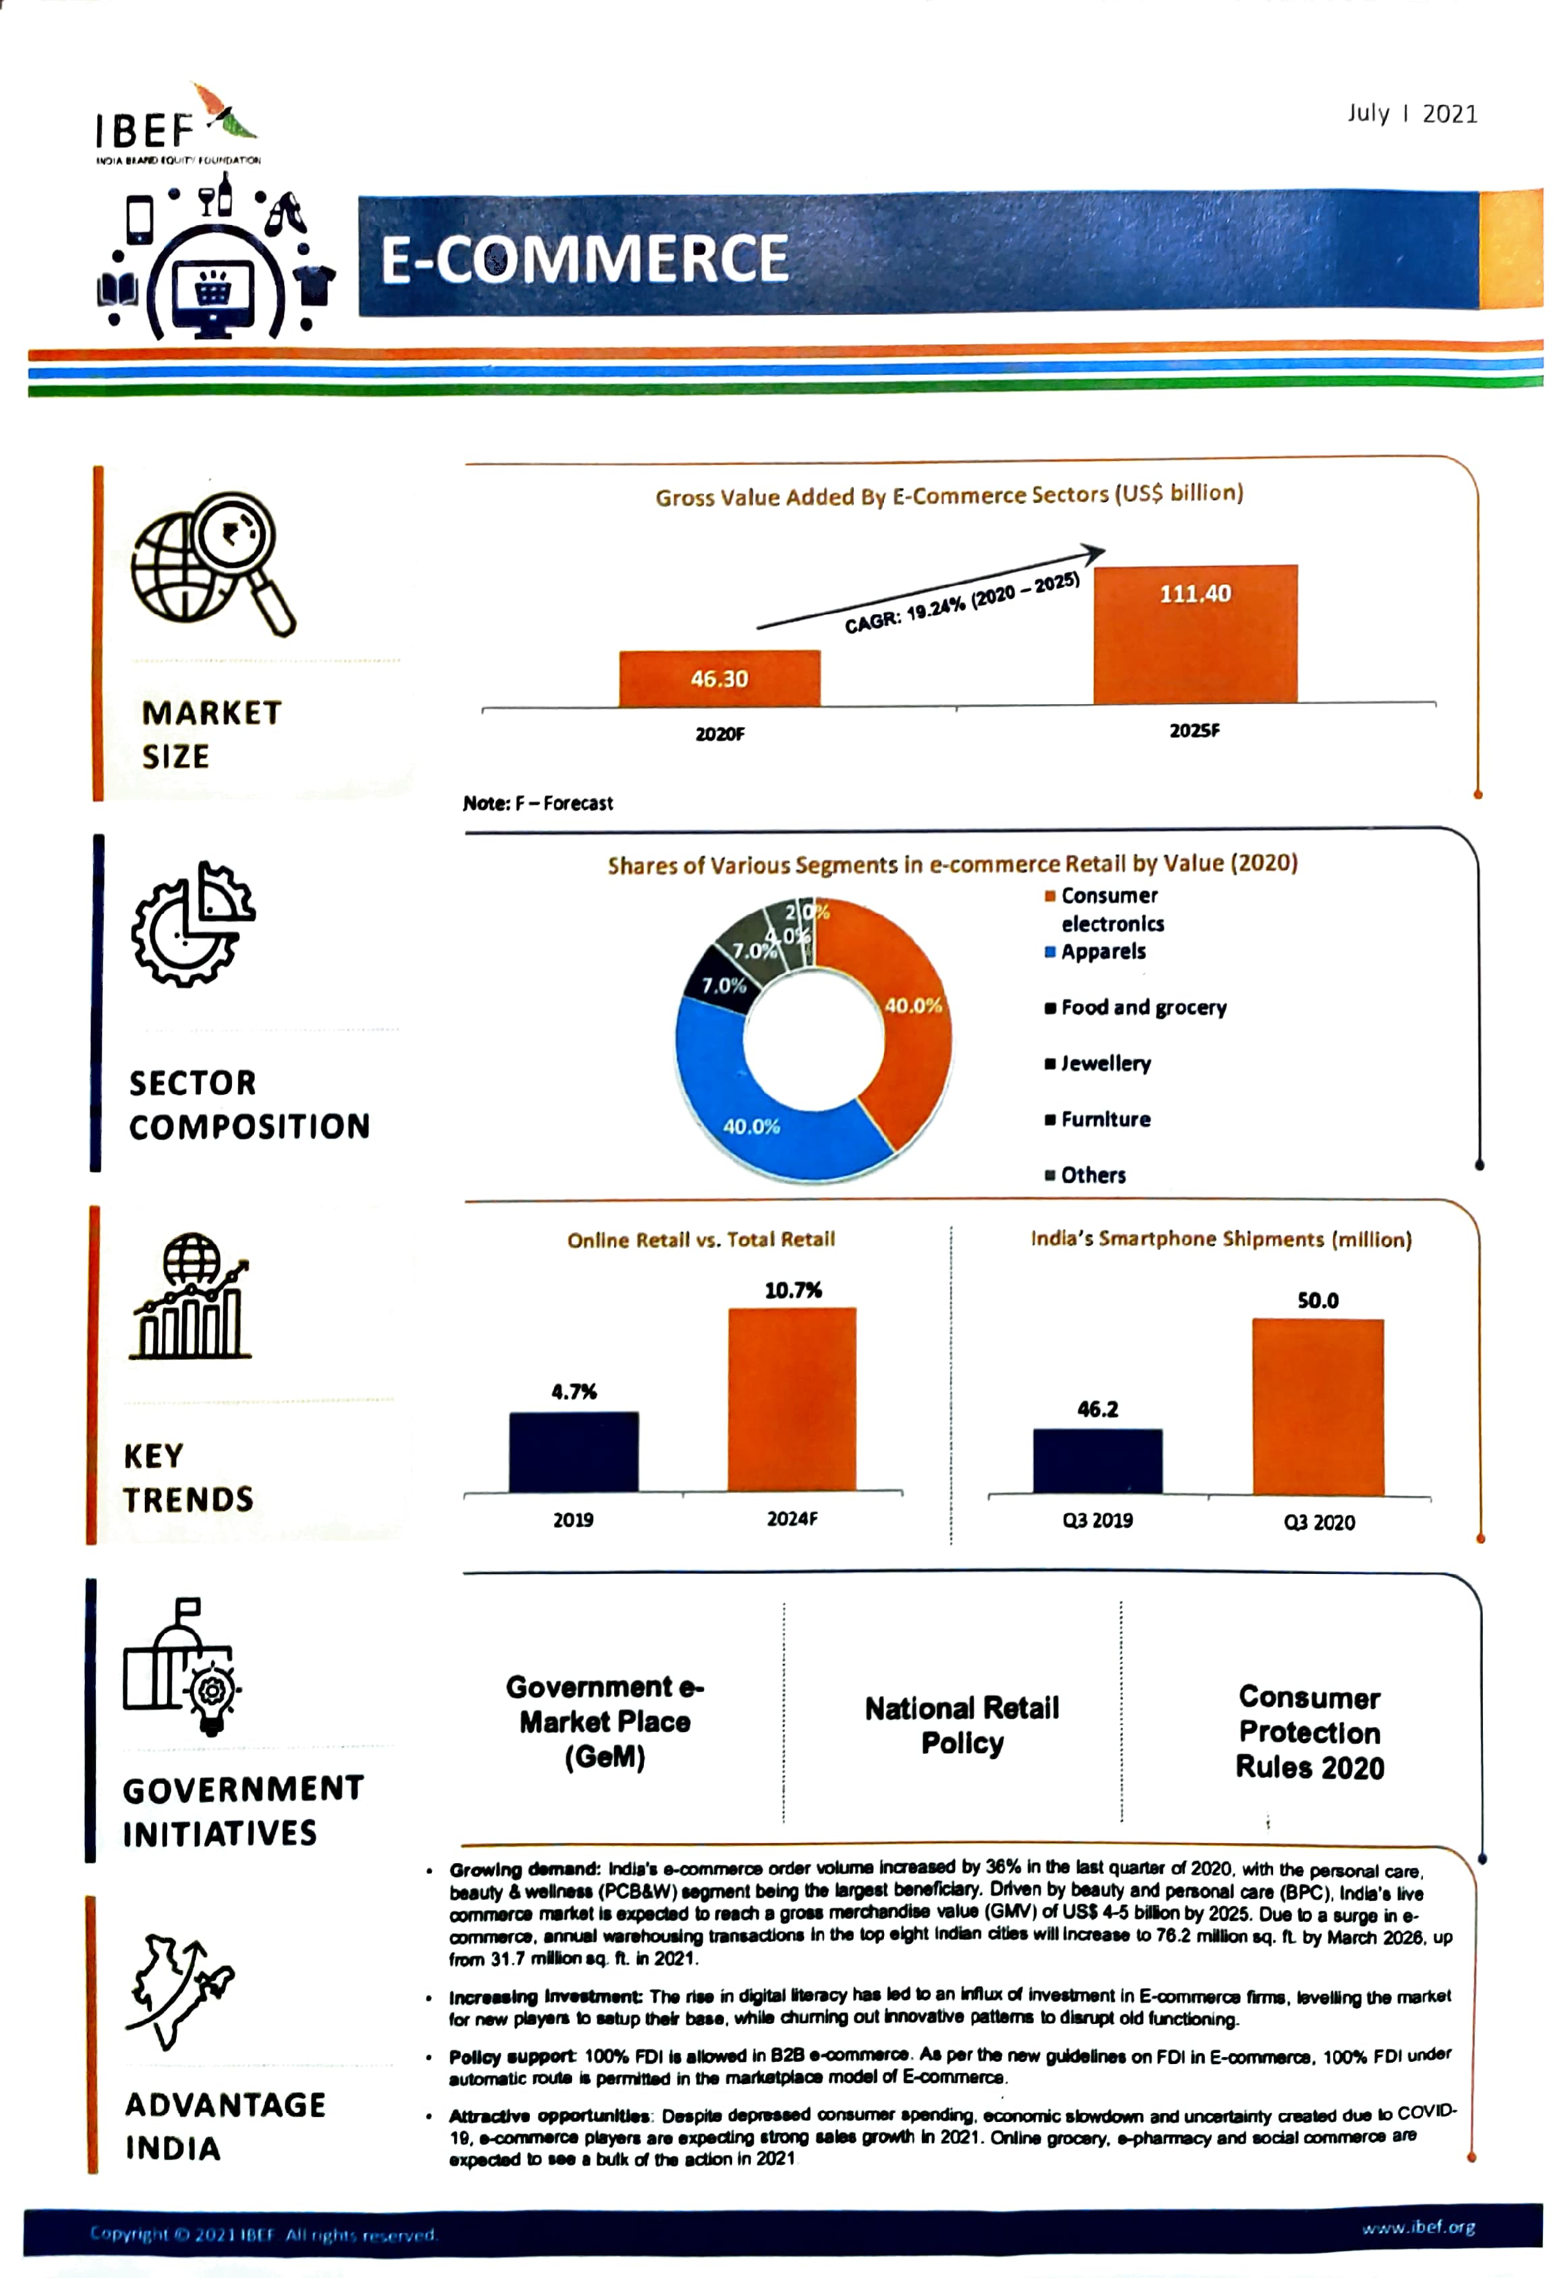
May Vacation Assignment

Slide 9
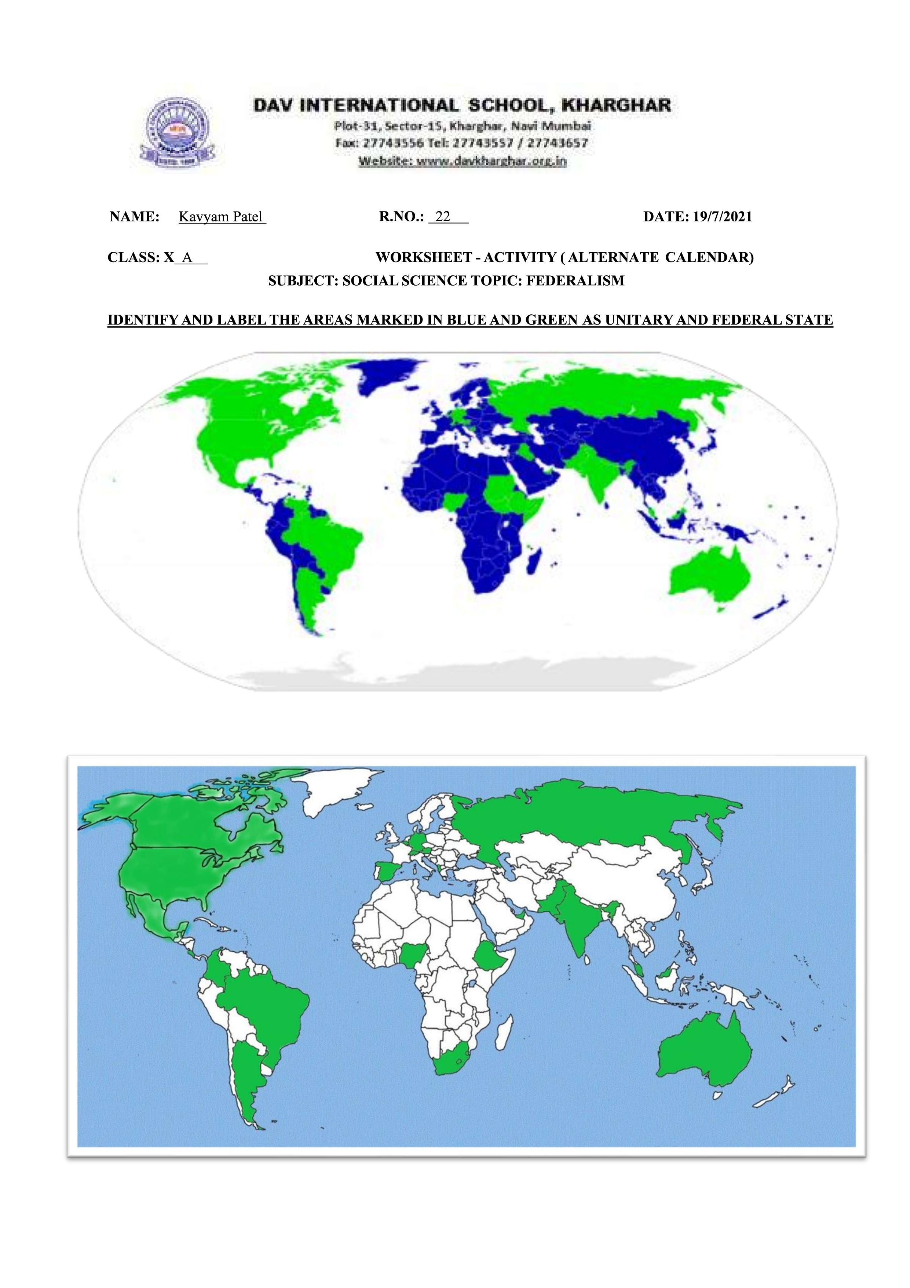
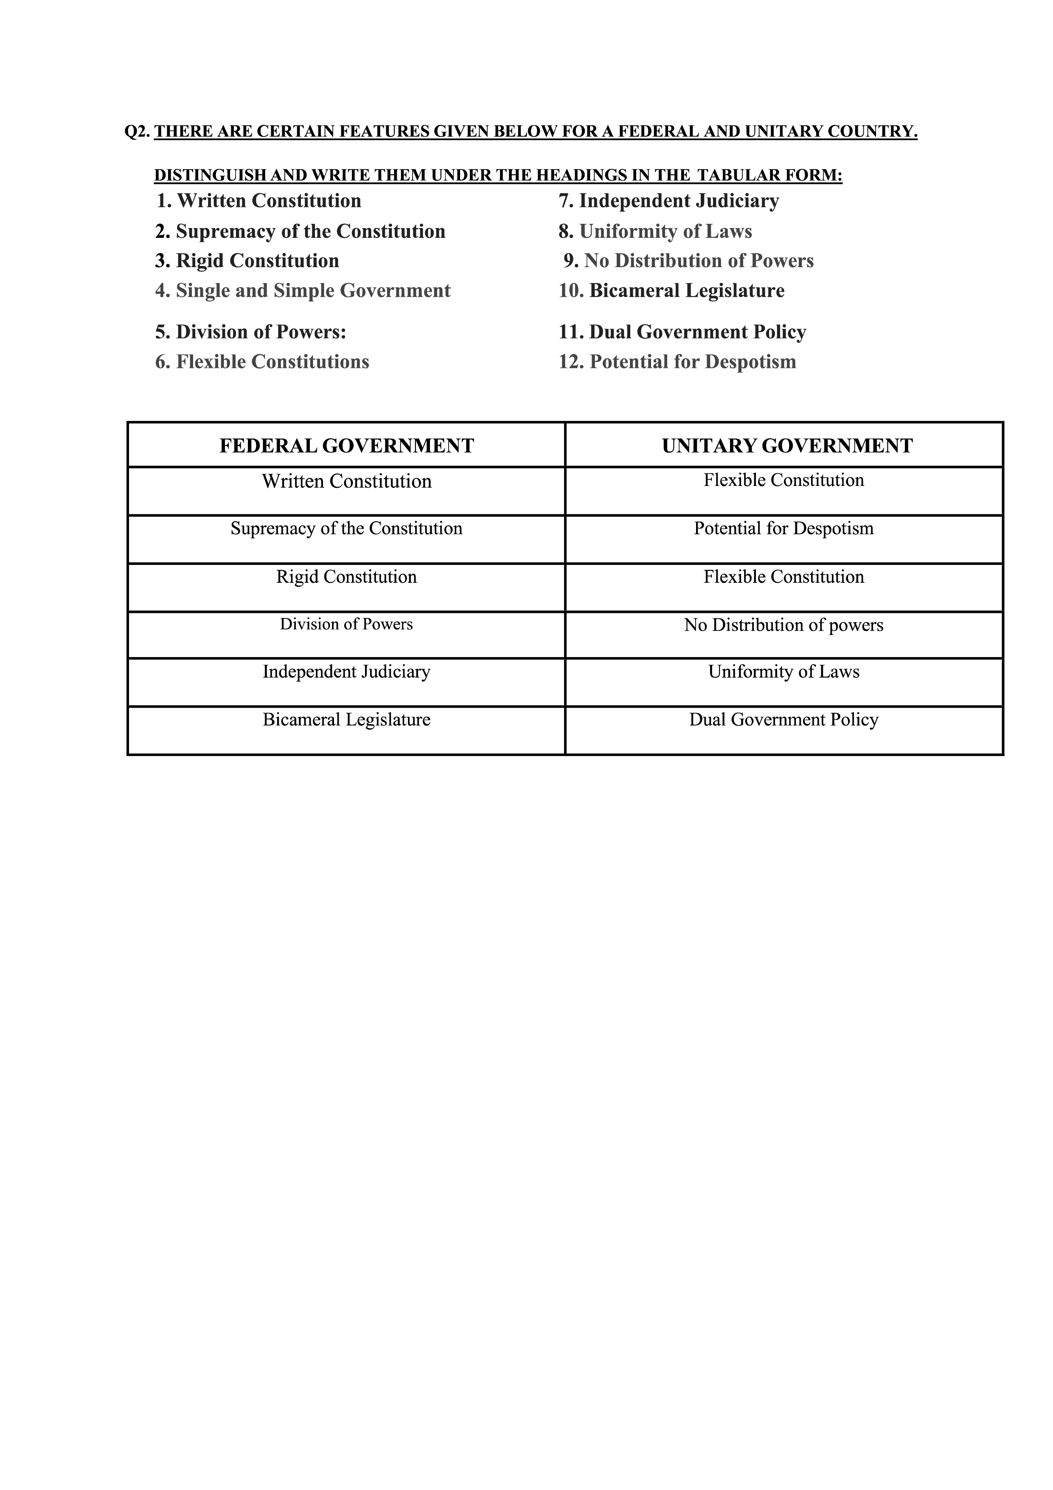
Alternate academic activity
July

Slide 10
Notes
Folder

Slide 11
Geography
Ch. No. | Chapter
1 | Resources and Development
3 | Water Resources
4 | Agriculture
5 | Minerals and Energy Resources
6 | Manufacturing Industries
7 | Lifelines of National Economy

Slide 12
Economics
Ch. No. | Chapter
1 | Development
2 | Sectors of Indian Economy
3 | Money and Credit
4 | Globalization and the India Economy

Slide 13
History
Ch. No. | Chapter
1 | Rise of Nationalism in Europe
2 | Nationalism in India

Slide 14
Democratic Politics
Ch. No. | Chapters
1 | Power Sharing
2 | Federalism
6 | Political Parties
7 | Outcomes of Democracy

Slide 15
THANK YOU
Kavyam Patel

